Slide 5
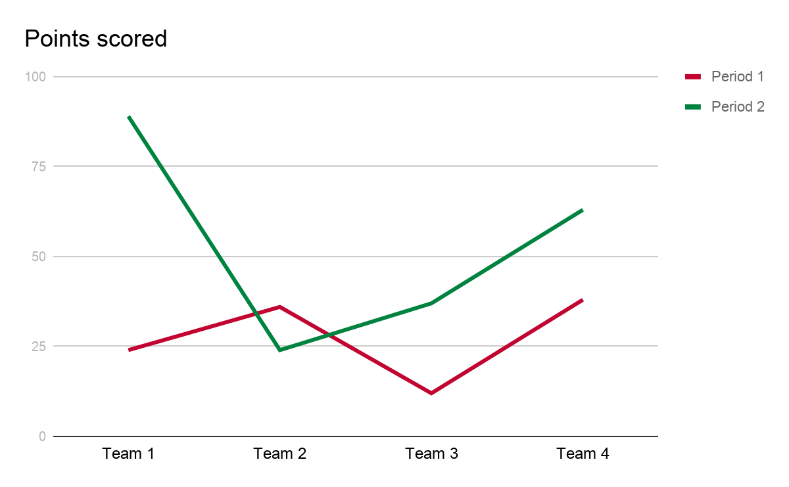
Пример графика

Slide 6
Example table
 | Period 1 | Period 2
Team 1 | 24 | 89
Team 2 | 36 | 24
Team 3 | 12 | 37
Team 4 | 38 | 63

Slide 7
How to place a photo
This is where you can insert a caption for a photo.
The photo is aligned to the top of the title and the bottom of this text box, it is the same width as the text block.

