Slide 1
Graduate School of Management SPbU
leading Business school in Russia*
January 2023
*according to the Financial Times MiM ranking (2013-2022)

Slide 2
GRADUATE SCHOOL OF MANAGEMENT IS THE STRUCTURAL UNIT OF ST PETERSBURG UNIVERSITY
1724
20 000
year
students
The oldest university of
Russia, founded by
emperor Peter The Great
SPbU is one of the largest
scientific and educational
centers in Europe
12 000
1993
staff
year
Nobel and Fields Prize
laureates also work at the
University
The Faculty of Management
was established in 1993, and
in 2006, within the national
project, it was transformed
into the Graduate School of
Management

Slide 3
VISION OF GSOM SPBU 2025 — BUSINESS SCHOOL №1 IN RUSSIA
DEVELOP LEADERS
We develop leaders, teams and organizations
at all stages of life experience in a unique multicultural educational environment
Create knowledge.
Develop leaders. Change the world for the better
10%
Share of alumni who participate
in lifelong learning
programs
50%
Courses
that use
digital solutions
30 thous.
Number of alumni from all programs annually
Global vision and expertise in management…
…adapted for the Russian labor market…
… for development of transformation leaders…
… at any stage of their career…
… in a unique educational environment...
…continually improving the school’s staff
>
>
>
1%
Bachelor programs in management
№1 in Russia
Selection of prospective students with high leadership potential
Plug&play graduates – ready for the labor market
Business school №1 in Russia for managers at any stage of their career
Master in Management №1 in Russia
Factory of specialized Master programs and flexible programs of Continuing Professional Education with the focus on online managers
Research environment
of the world-class level
Research centers – international leaders in their spheres
The Leader in creation of knowledge in partnership with business
5%
1,5 тыс.
1%
51 место
15%
Share of ESG disciplines in the curriculum
Топ-15
Top-30
РThe ranking of European
business school according to the FT
The Leader in creation of unique content
Micromodular adaptive open architecture of content with continuous
updating in a digital educational environment
Advanced team of the Business School
The best employer for the faculty and researchers in Russia
Top-3
University business school for leading employers
Global vision and variety of approaches
Digital educational environment
Modern high-tech campus
Career development at all stages
Alumni –
ambassadors of GSOM SPbU
Change the world
for the better
Create knowledge
Role model of partnership of business and SPbU for the development of the university business school: Reinvestment in development of the school
Operating model
Accountability and sustainable development
as a foundation for an academic model of the business school
Educational products
and research of the world-class level in partnership with business, state and leading scholars
>
The leading brand in business education in Russia
2020
2025

Slide 4
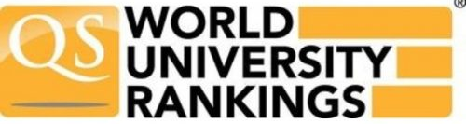
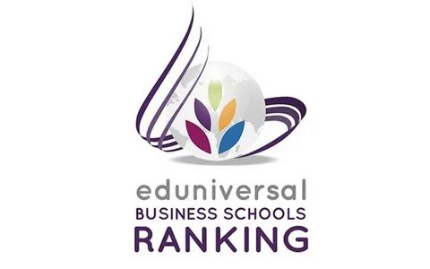
GSOM SPBU IS A SUCCESSFUL UNIVERSITY BUSINESS SCHOOL IN RUSSIA AND IN THE WORLD
ONE OF THE BEST BUSINESS SCHOOLS IN RUSSIA AND EASTERN EUROPE
GSOM SPbU IS IN THE TOP 1% OF THE BEST BUSINESS SCHOOLS IN THE WORLD WITH THE “TRIPLE CROWN” OF ACCREDITATIONS
according to the Financial Times European Business Schools Ranking
8 500+
1 350
250
62
5
18
Counts an alumni community
since 1997
Students study at GSOM SPbU annually
Выпускников основных образовательных программ
Full-time professors
Foreign professors
Professors under 40
92.9
29/15
89/33/15
HIGH POSITIONS IN THE WORLD RANKINGS
EMBA ranking 2022
Average USE score for Bachelor admission GSOM SPbU is the highest in St. Petersburg
Foreign universities from 15 countries continue to provide places for GSOM SPbU students for exchange studies
89 — total number of foreign academic partners; with 33 we continue partnership, 15 — potential foreign academic partners
21
79
44
European Business Schools 2022
71–
80
111–
120
3
TOP Business Schools Eastern Europe
QS Business Masters Rankings: Business Analytics 2022
QS Global Executive MBA Rankings 2022, QS Business Masters Rankings: Management 2022
130+
121–
130
39
Russian and CIS universities got access to modern teaching methods
in the digital environment developed by GSOM SPbU
QS Business Masters Rankings: Finance 2022
NEW PRIORITIES
Moscow International Ranking "Three Missions of the University" Decree of the Government of the Russian Federation No. 326 from 5.03.2021
*Data based of 15.12.2022

Slide 5
GSOM SPBU OFFERS PROGRAMS FOR THE DEVELOPMENT OF LEADERS AT ALL STAGES OF A CAREER
Bachelor programs
Master and Doctoral programs
(in English)
МВА and Еxecutive МВА
Corporate
programs
ENG
GSOM SPbU and Business School XXI Century Consult jointly launched an MBA program in Belarus
GSOM SPbU and GSB AlmaU (Kazakhstan) jointly implement the EMBA double degree program
Joint program with Skillbox "MBA - Leaders of Change" (online)
Active recruitment for MBA and EMBA programs
ONLINE:
Essentials programs for line managers
Series of educational webinars and trainings on various topics
OFFLINE:
Corporate MBA programs
Leadership programs for managers of different levels
Talent pool development programs
Public Administration
Management
International Management (in English)
Master in Management
Master in Corporate Finance
Master in Business Analytics & Big Data
Master in Smart City Management
Doctoral program in management

Slide 6
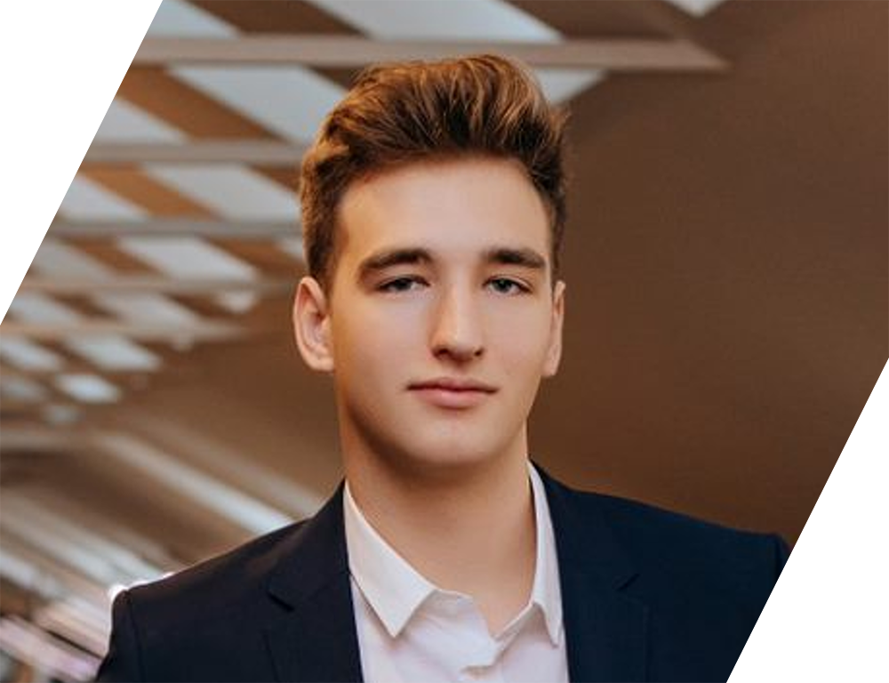
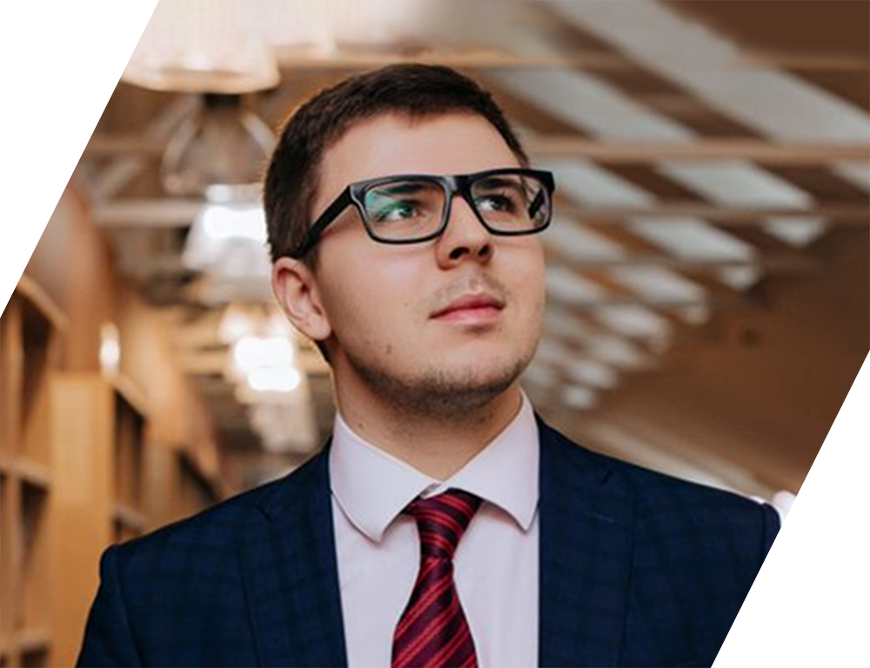
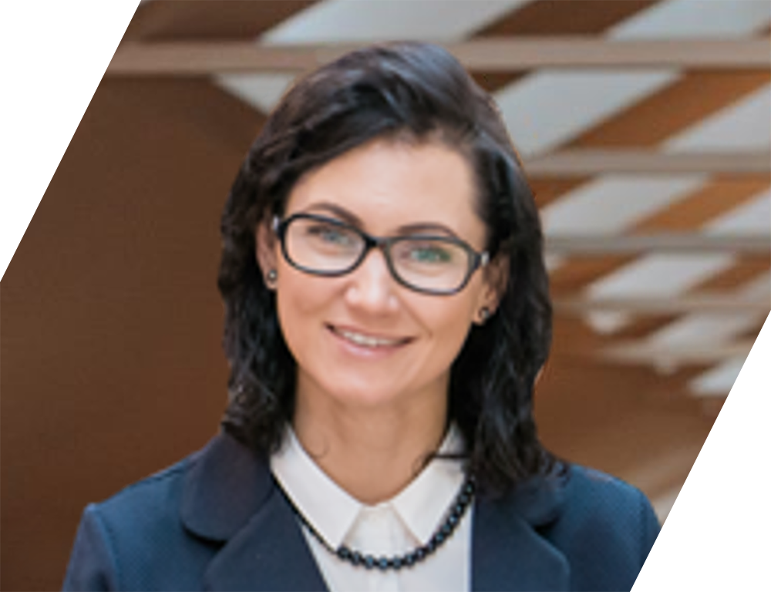
GSOM SPbU TODAY: PROFILE of an applicant at different degree programs
Bachelor (undergraduate) programs
Doctoral program applicant
Motivation: education at a prestigious university, highly paid job, practical skills, in demand profession
Motivation: job at a business school or business / economics university (including international)
Regions: mostly St Petersburg
Location
Russian regions
Location
Occupation
20%
50%
70%
70%
18-20 y.o.
25-35 y.o.
20%
50%
30%
30%
Master (graduate) programs
Applicant for MBA/EMBA programs
Motivation: highly paid job (usually large companies), applicable management skills
Motivation: structuring managerial experience, reaching a new stage in career development,
bringing business to a new level
Occupation: Bachelor programs’ alumni
Location: mostly Russia
Location
Russian regions
Regions: mostly St Petersburg
60%
40%
Occupation: top managers of medium-sized businesses, line managers of large companies, business owners
22-25 y.o.
35-55 y.o.
40%
60%

Slide 7
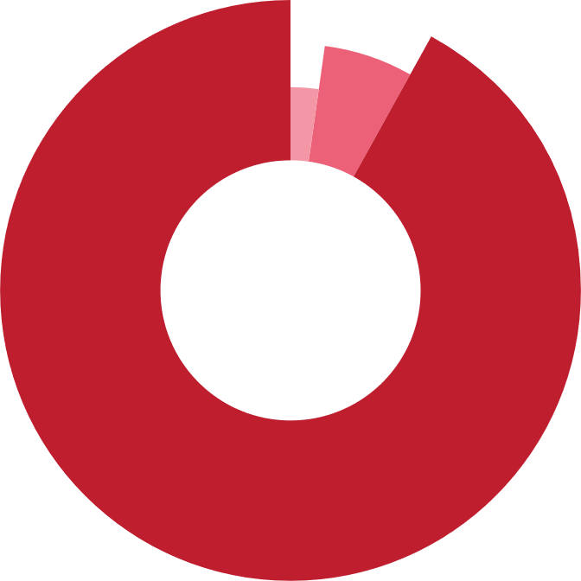
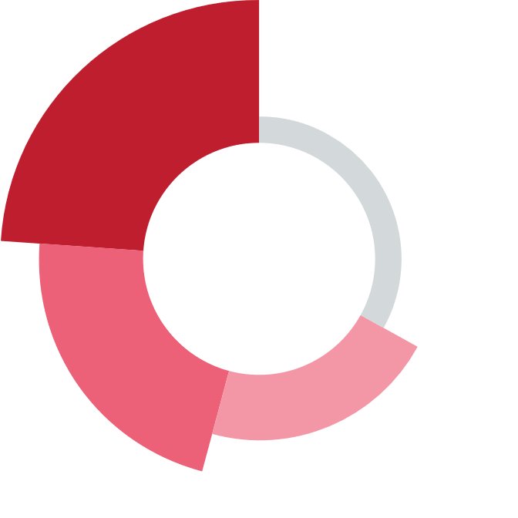
GSOM SPbU TODAY: GRADUATE PROFILE OF MAIN EDUCATIONAL PROGRAMS
GSOM SPbU Bachelor and Master programs' graduate is highly paid specialist working in a large company in the Russian Federation *
THE MOST IMPORTANT COMPETENCES, WHICH GRADUATES HAVE ACQUIRED DURING THE YEARS OF STUDY AT GSOM SPbU
LOCATION
EMPLOYMENT
71%
Russia (64% SPb, 31% Moscow)
92%
company employees
17%
EU
6%
Entrepreneurs
Adaptability
Understanding of business processes
12%
Other countries
2%
Freelancers
Think big
Sociability
Find solutions
Ability to learn
multitasking
MONTHLY INCOME
COMPANY SIZE
Public performance
strategic thinking
29%
90 000 — 149 000 rub.
24%
500 — 4999 employees
Teamwork
critical thinking
analytical thinking
25%
150 000 — 299 999 rub.
22%
More than 50 000 employees
Time management
Confidence
Networking
Stress tolerance
17%
More than 300 000 rub.
21%
5000 — 49 999 employees
*based on surveys by GSOM Career Center. Graduates of Bachelor and Master programs in 2017, 2019, 2021 and 2022, n=294, 2022.

Slide 8
GSOM SPBU CREATES KNOWLEDGE AND CONTRIBUTES TO ITS DISSEMINATION
Center for Entrepreneurship
Teaching Excellence Lab (TEL)
NEW
NEW
Center of Digital Education Technologies
Center for Public Private Partnership Studies
NEW
Center for Executive Education Online programs
Center for Corporate Social Responsibility
NEW
Center for Russian Multinationals and Global Business
Case of Russian Central Bank
and the National Card
Payment System "MIR"
Case Development Center

Slide 9
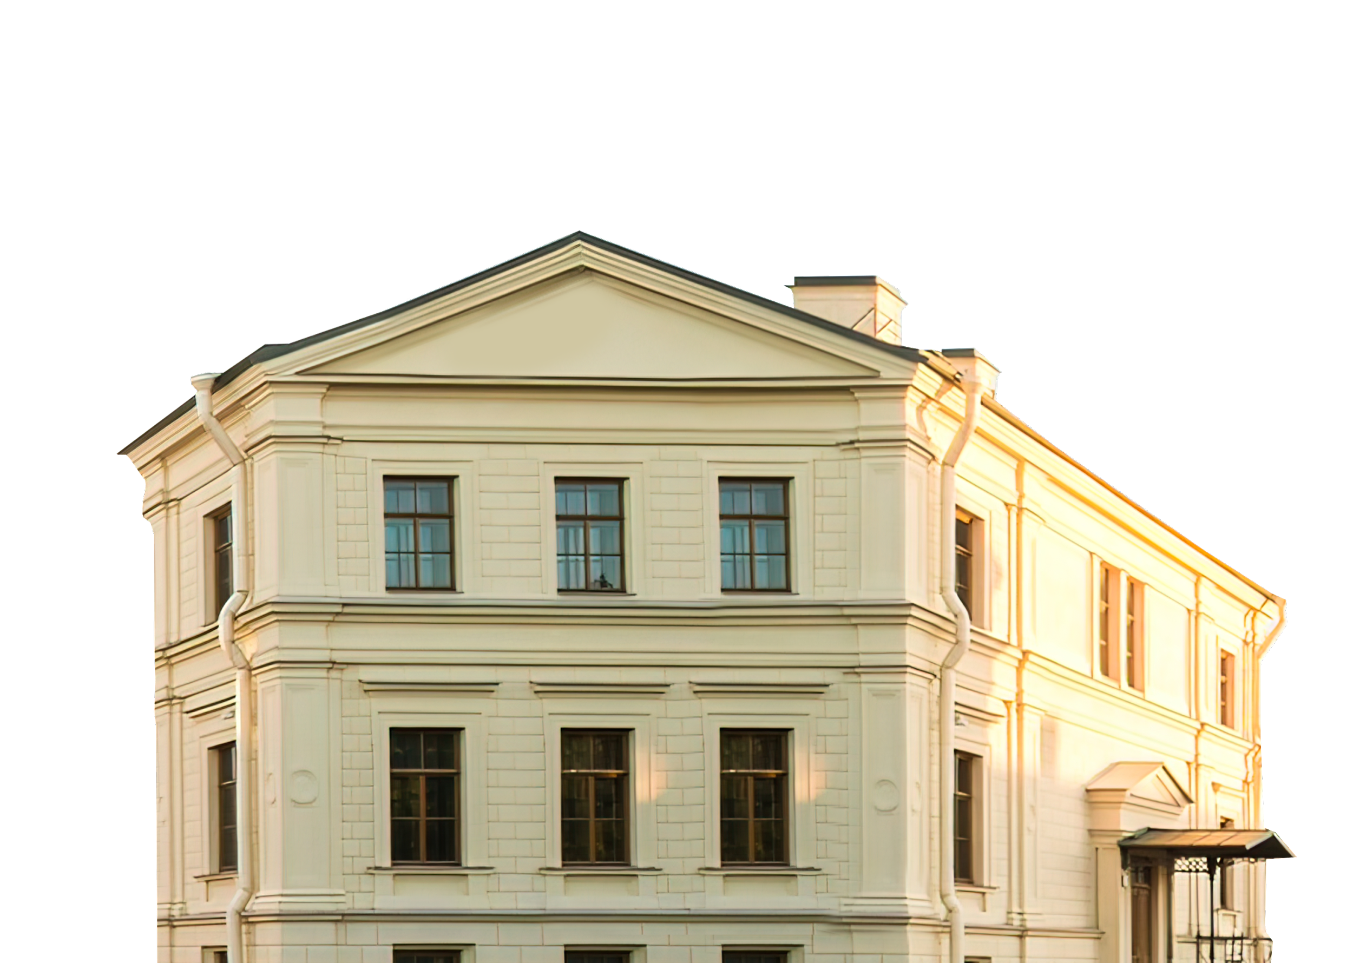
KEY ADVANTAGES OF GSOM SPBU
World-class management education
GSOM SPbU is in the top 1% of the best business schools in the world
Has high positions in expert rankings
The only Russian business school with the "triple crown" of international accreditations
Support in starting a successful career
GSOM SPbU guarantees its alumni the demand for the labor market
GSOM SPbU Career Center contributes to the careers' building in line with changing market needs
Modern teaching methods
in the digital environment
GSOM SPbU has its own methodology for teaching in a digital educational environment in a hybrid format
GSOM SPbU owns OWL LMS platform that provides convenient access to educational content
Strong community
The community that will always support – more than 8500 alumni, faculty, partners and students of GSOM SPbU around the world are always in touch
Mentoring programs, business clubs, alumni reunions and other useful events
Multicultural environment
GSOM SPbU uses the best world practices and ensures intercultural interaction thanks to a partner network all around the world
Comfortable campuses for study and development
Building in the historical center of St Petersburg
Unique suburban campus "Mikhailovskaya Dacha" in Peterhof with dormitories for 600 students

Slide 10
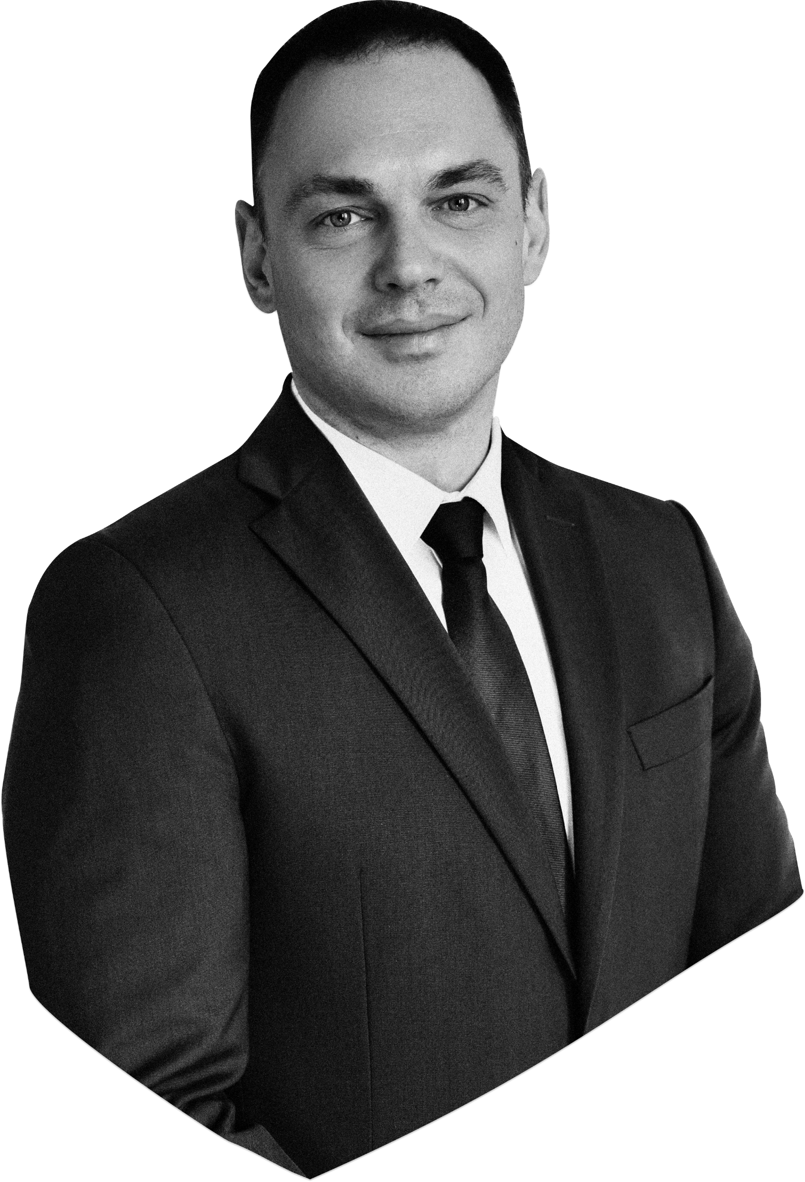
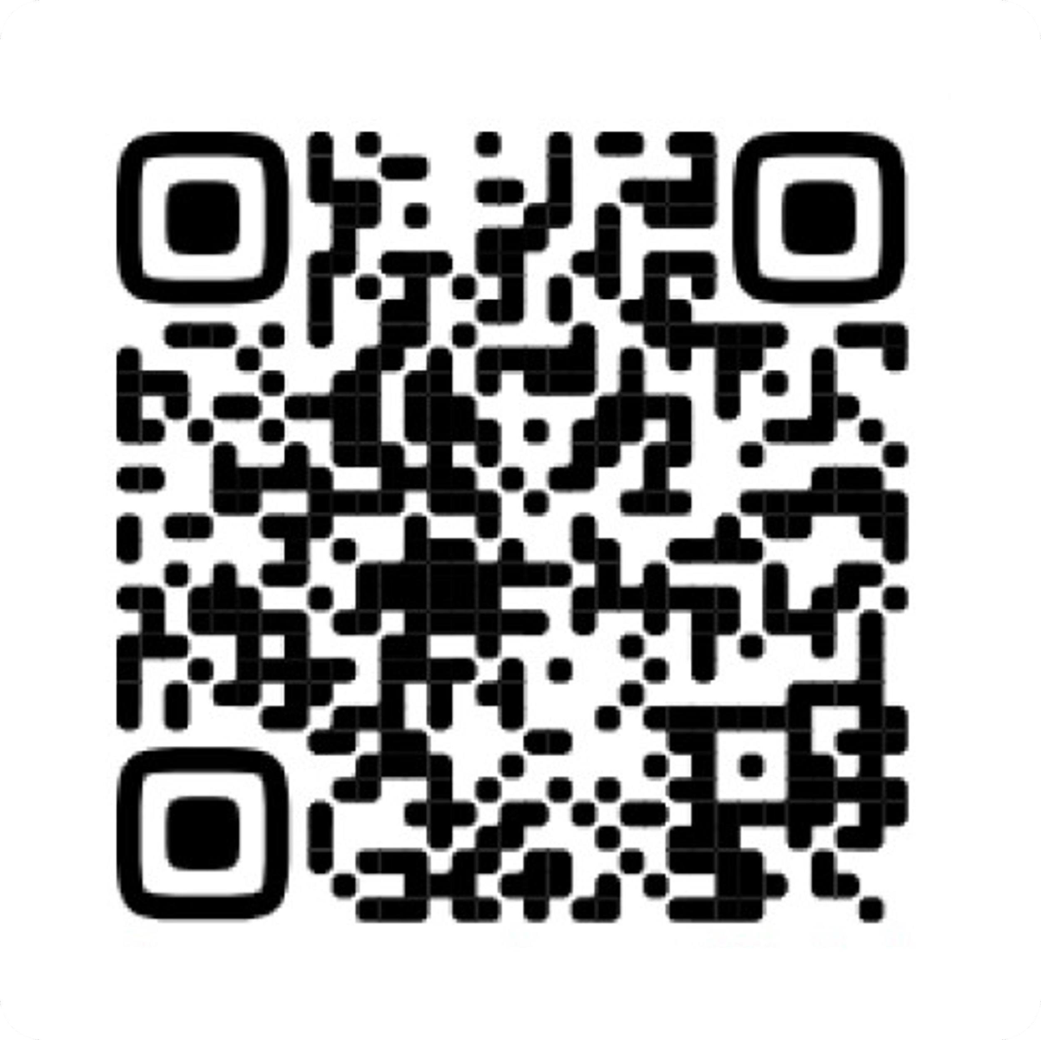
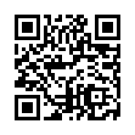
Telegram
Subscribe to the official channel of GSOM SPbU:
in Telegram (available in Russian only)
in Linked In (available in English)
@gsom_spbu_official
Linked In
linkedin.com/school/gsom.spbu/

